Slide 1
Towards a new conceptualisation of marginalisation: Case Study Workbook
Dr Joan Mowat
University of Strathclyde, Scotland

Slide 2
resilience
Risk Factors Individual & Social
Personality Traits; Family Networks; .... eg. post-natal depression
Protective Factors Individual & Social
Personality Traits; Family Networks; .... eg. support from wider family
Protective Factors Societal/ Political
Norms, Values, Policies, Systems & Structures eg. inclusive ethos
Risk Factors Societal/ Political
Norms, Values, Policies, Systems & Structures eg. poverty
Culture
Within time & place
Societal Norms, Values & Expectations
Dr Joan Mowat, University of Strathclyde, Glasgow, Scotland

Slide 3
Examining Thomas’ Case
What are the risk and protective factors at the individual & social and the societal/political levels which help us to understand Thomas’ subjective experience and what is valued by him?

Slide 4
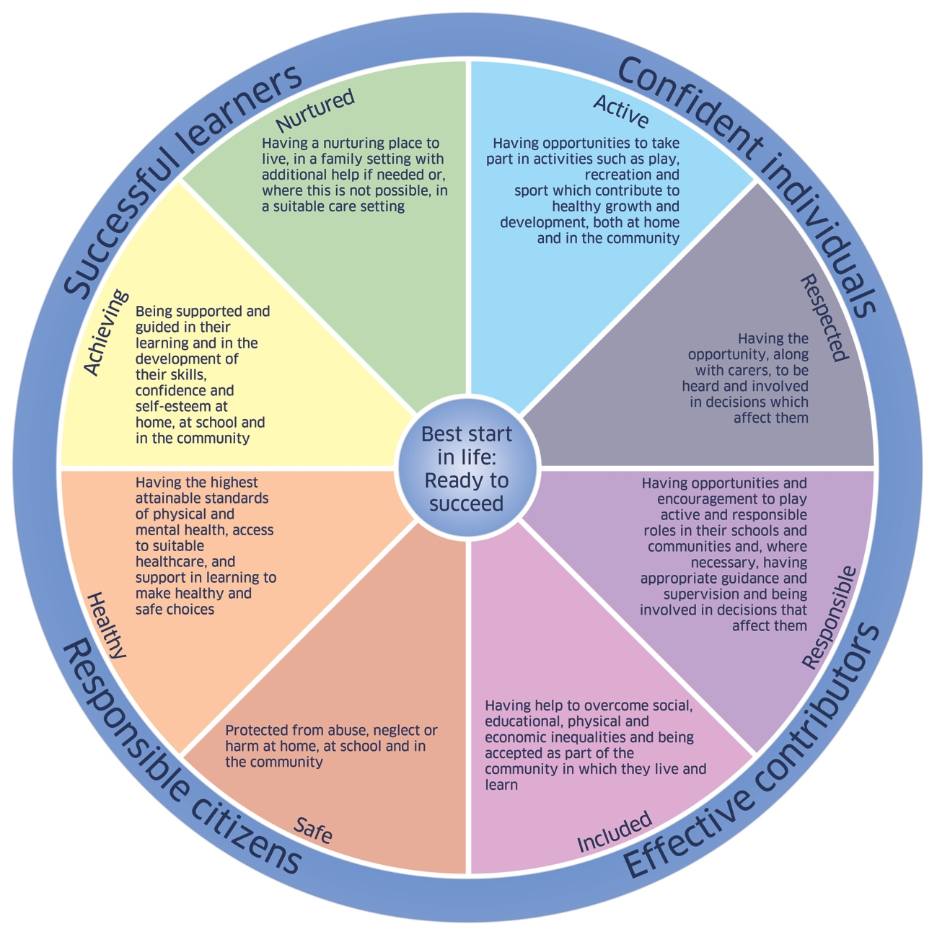
The Wellbeing Wheel
Scottish Government 2012

Slide 5
The interaction between what is valued by the individual & by society
Given what we have learned about Thomas and the circumstances pertaining to him, what is the congruence between the espoused aims of the Scottish Government as expressed in GIRFEC, and Thomas’ subjective experience and what is valued by him?

Slide 6
6
Marginalisation
Valued by individual but not by society
Not valued by individual but valued by society
Not valued either by the individual or society
Valued by individual and by society
What is valued by the individual
What is valued by society
The Experiences of the Individual as Interpreted by them
Located within time, place and culture, mediated by the political context and power
Societal Norms, Values & Expectations
Risk Factors Individual & Social
Protective Factors Societal/ Political
Risk Factors Societal/ Political
Protective Factors Individual & Social
Dr Joan Mowat, University of Strathclyde, Glasgow, Scotland

Slide 7
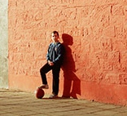
Bringing this all together, what does it tell us about the extent to which Thomas may have experienced his life as marginalised or not, and whether this could be considered to be a stable state or transient; global or specific to context?

Slide 8
Questions
If we accept that marginalisation encompasses not just a state but feelings about that state and is concerned with the subjective experience of the individual and what is valued by them (shaped by societal norms, values and expectations), how does this represent a paradigm shift in our thinking about marginalisation?
Likewise, if we accept that marginalisation may not be a global state (may not be applicable to all aspects of an individual’s life) and may be context specific, what are the implications for this in how we think about marginalised groups?
Do these conceptualisations question the whole notion of marginalised groups or is this still a useful concept?
Is resilience a useful lens through which to examine marginalisation?
What then are the implications for social justice and inclusion for young people and children and for public policy of the above?

