Slide 1
Towards a new conceptualisation of marginalisation: Case Study
Dr Joan Mowat
University of Strathclyde, Scotland

Slide 2
Outline
Introducing the case study
Examination of the case study
Examination of the concept of marginalisation and its implications for policy and practice

Slide 3
Outline Part 1
The Political context
The Local Community
Introducing Thomas
The Intervention
Thomas’ response to the intervention

Slide 4
The political context
A genuine commitment to eradicating poverty and promoting social justice within Scottish policy context over time (Scottish Government 2010)
Within the shadow of a ‘quasi-market’ philosophy of education in which schools compete for the spoils and there are winners and losers – some children are more valued than others (Ainscow, Booth and Dyson 2006)

Slide 5
The Local Community
Hitherto an important industrial centre in the West of Scotland – now an area of high unemployment (West Dunbarton Council 2012)
25% of parents living on benefits and 25% of children entitled to free school meals
Very poor health indicators – the LA at the top or near the top of all-cause mortality and suicide rates, particularly for young men
Men had a life-expectancy of 3 years less (and women 2 years less) than the average Scottish popuuation
LA had 2nd highest rate of recorded crime in Scotland (Greater Glasgow Health Board 2007)
LA rated poorly on all indicators of deprivation (Scottish Government 2012a)

Slide 6
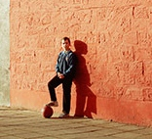
Thomas
The younger of two brothers living with his mother and step-father. His elder brother in trouble with the police.
His mother had remarried and had a younger child
Referred to Psychological Services in primary school
Directed towards groupwork intervention in primary school but did not respond
Did not cope well with transition to secondary school
Frequently suspended from school for serious misconduct following transition to secondary school

Slide 7
Thomas
Referred to inter-professional team within school – JAT – and to Behaviour Support Base
Behaviour continued to deteriorate – missed 2/5ths of potential schooling through suspensions in S2
Not allowed to participate in scheme to support vulnerable families and children because of the risk he posed to others
Referred to LA for potential placement outwith mainstream because it was considered that he was beyond control

Slide 8
Thomas
His mother, whilst being concerned for her son, eventually refused to attend appointments at the school
His pastoral care teacher gave up on him – refused to refer him to support group intervention on the basis that Thomas would not respond - No chance of success. Wouldn’t turn up, would have no effect
Thomas on the fringes of trouble within the community
At age 14, witnessed a murder in the local community
His elder brother at a later point committed suicide

Slide 9
Intervention
Social constructivist groupwork approach designed to foster understanding and transfer
Based upon the Teaching for Understanding Framework (Wiske 1998)
Focussed upon developing intrapersonal and interpersonal intelligences (Gardner 1999)
Nominated by myself (Depute Head) to Support Group
Placed in group (N = 4) with Behaviour Support Teacher
Attended group work for a period of 20 weeks for 1hr per week

Slide 10
Response to Intervention
Contrary to expectation, responded very positively to approach and contributed actively to discussions and activities
Positive relationships formed between Support Group Leader and Thomas and between Thomas and other pupils in group
Key is that someone took an interest in him. Positive relationships with teachers are very important. The group gave him time out from coursework to think about himself. (I) don’t think they ever get the chance to do this.
Mr McDonald [Support Group Leader]

Slide 11
Response to Intervention
He had developed a sense of agency – Realised that you could change things ‘yerself’
There were significant improvements in his behaviour – a 75% reduction in referrals for indiscipline from his class teachers reflected also in a significant reduction in suspensions from school
Relationships with peers were considered to be improving
He reported feeling happier, having a sense of being cared about and being listened to - Teachers listen to what you have to say rather than just dishing out the orders.

Slide 12
Response to Intervention
His attitude towards school and towards learning was more positive – It used to be, “I don’t want to go to school” but that’s stopped and I suppose it’s because he’s coping better. [Thomas’s Mum]
Thomas stated, I am doing about 10 times better than what I used to and attributed this to both the support group and the influence of his stepfather who acted as a role model for him.
Despite obvious improvements, it proved difficult to shift Thomas’ poor reputation – it seemed intractable – some of his teachers noted no change in his behaviour or attitude

Slide 13
Outline: Part 2
Examining Thomas’ Case Study through the lens of resilience
An examination of the extent to which Thomas may have experienced his life as marginalised
Examination of the concept and the implications of the hypothesis

Slide 14
Examining Thomas’ Case through the lens of resilience

Slide 15
Resilience
Risk Factors Individual & Social
Personality Traits; Family Networks; .... eg. post-natal depression
Protective Factors Individual & Social
Personality Traits; Family Networks; .... eg. support from wider family
Protective Factors Societal/ Political
Norms, Values, Policies, Systems & Structures eg. inclusive ethos
Risk Factors Societal/ Political
Norms, Values, Policies, Systems & Structures eg. poverty
Culture
Meanings, beliefs, values & practices
Within time & place
Societal Norms, Values & Expectations
Mowat 2014
Notes:
Mediated through Societal Norms, Values & Expectations (bottom of slide)

Slide 16
Resilience
The Experiences of the Individual as Interpreted by them
Risk Factors Individual & Social
Personality Traits; Family Networks; .... eg. post-natal depression
Protective Factors Individual & Social
Personality Traits; Family Networks; .... eg. support from wider family
Protective Factors Societal/ Political
Norms, Values, Policies, Systems & Structures eg. inclusive ethos
Risk Factors Societal/ Political
Norms, Values, Policies, Systems & Structures eg. poverty
Mowat 2014

Slide 17
Resilience
What is valued by the individual
Highly complex and subjective
The Experiences of the Individual as Interpreted by them
Mowat 2014

Slide 18
Examining Thomas’ Case
Risk Factors Individual & Social
Personality Traits; Family Networks; .... eg. post-natal depression
Protective Factors Individual & Social
Personality Traits; Family Networks; .... eg. support from wider family
Protective Factors Societal/ Political
Norms, Values, Policies, Systems & Structures eg. inclusive ethos
Risk Factors Societal/ Political
Norms, Values, Policies, Systems & Structures eg. poverty
Mowat, 2014, building upon Olsson et al., 2003
What are the risk and protective factors at the individual & social and the societal/political levels which help us to understand Thomas’ subjective experience and what is valued by him?

Slide 19
Moving beyond Thomas’ subjective experience to examining the extent to which Thomas may have experienced his life as marginalised or not and whether this could be considered to be a stable state or transient, global or specific to context

Slide 20
The relationship between resilience and the subjective experience of marginalisation
Valued by individual but not by society
Not valued by individual but valued by society
Not valued either by the individual or society
Valued by individual and by society
What is valued by the individual
What is valued by society
Mowat 2014
Notes:
The argument being forwarded is that the extent to which an individual may or may not experience their lives as marginalised may depend upon the extent to which they value whatever it is they are considered to be marginalised from.

Slide 21
The relationship between resilience and the subjective experience of marginalisation
May experience marginal-isation, but may not be recognised
May experience marginal-isation
Valued by individual but not by society
Not valued by individual but valued by society
Not valued either by the individual or society
Valued by individual and by society
Unlikely to experience marginal-isation
May not experience marginal-isation, contrary to expectation
If lacking
Mowat 2014
Notes:
The argument being forwarded is that the extent to which an individual may or may not experience their lives as marginalised may depend upon the extent to which they value whatever it is they are considered to be marginalised from.

Slide 22
The relationship between resilience and the subjective experience of marginalisation
What is valued by society
All complex concepts
Culture
Meanings, beliefs, values & practices
Within time & place
Societal Norms, Values & Expectations
Mowat 2014

Slide 23
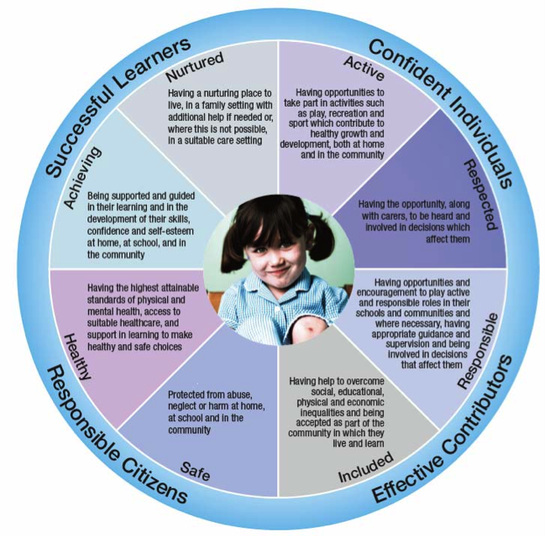
What is valued by society
As represented within the Scottish policy context
Getting it Right for Every Child [GIRFEC}
Scottish Government 2012b

Slide 24
The interaction between what is valued by the individual & by society
Valued by individual but not by society
Not valued by individual but valued by society
Not valued either by the individual or society
Valued by individual and by society
Given what we have learned about Thomas and the circumstances pertaining to him, what is the congruence between the espoused aims of the Scottish Government as expressed in GIRFEC, and Thomas’ subjective experience and what is valued by him?

Slide 25
Bringing this all together, what does this tell us about the extent to which Thomas may have experienced his life as marginalised or not, and whether this could be considered to be a stable state or transient; global or specific to context?

Slide 26
Questions
If we accept that marginalisation encompasses not just a state but feelings about that state and is concerned with the subjective experience of the individual and what is valued by them (shaped by societal norms, values and expectations), how does this represent a paradigm shift in our thinking about marginalisation?
Likewise, if we accept that marginalisation may not be a global state (may not be applicable to all aspects of an individual’s life) and may be context specific, what are the implications for this in how we think about marginalised groups?
Do these conceptualisations question the whole notion of marginalised groups or is this still a useful concept?

Slide 27
Questions
Is resilience a useful lens through which to examine marginalisation?
What then are the implications for social justice and inclusion for young people and children and for public policy of the above?

Slide 28
References
Ainscow, M., T. Booth, and A. Dyson. 2006. "Inclusion and the standards agenda: negotiating policy pressures in England." International Journal of Inclusive Education 10 (4-5):295-308.
Gardner, H. 1999. Intelligence Reframed: Multiple Intelligences for the 21st Century. New York: Basic Books.
Greater Glasgow Health Board. 2007. The Health of the People in West Dunbartonshire Glasgow: Greater Glasgow Health Board.
Wiske, M.S. 1998. Teaching for Understanding: Linking Research with Practice. San Francisco, CA: Jossey-Bass.
Scottish Government. 2010. The Child Poverty Act. http://www.scotland.gov.uk/Publications/2010/11/15103604/7
Scottish Government. 2012a. "Index of Multiple Deprivation ". http://simd.scotland.gov.uk/publication-2012/.
Scottish Government. 2012b. Getting it Right for Every Child: Where are we now? Edinbugh: HMSO.
West Dunbartonshire Council. 2012. Social and Economic Profile 2011-2012. http://www.west-dunbarton.gov.uk/media/3901683/social_and_economic_profile_2011-12.pdf

